Slide 1
Unit 1 Regression modeling Simple regression in R
Fall 2019
September 4

Slide 2

Simple Linear Regression using R
Advertising Data
This data set includes “Sales (in thousands of units)” for a particular product as a function of “Advertising budgets (in thousands of dollars)” for TV, Radio, and Newspaper media.
Examine the effectiveness of traditional media channel on sales.
Investigate the relationship between sales and 3 different ad channels.

Slide 3
Simple Linear Regression using R
Is there a relationship between advertising budget and sales?
How strong is the relationship between advertising budget and sales?
Is the relationship linear?
Which media contribute to sales?
How accurately can we estimate the effect of each medium on sales?
How accuracy can we predict future sales?
Is there synergy among the advertising media?

Slide 4
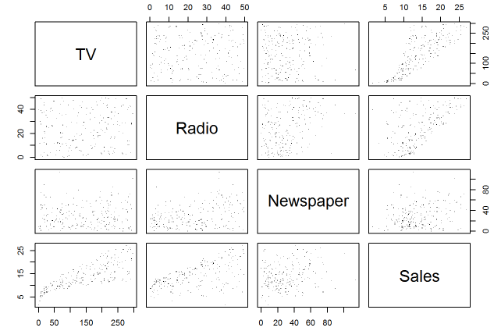
Simple Linear Regression using R
1. Is there a relationship between advertising budget and sales?
pairs() or gpairs()
A few important questions that we might seek to address.

Slide 5
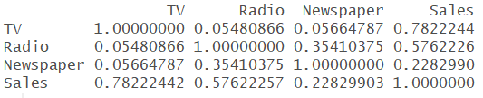
Simple Linear Regression using R
2. How strong is the relationship between advertising budget and sales?

Slide 6

Simple Linear Regression using R
3. Is the relationship linear?

Slide 7
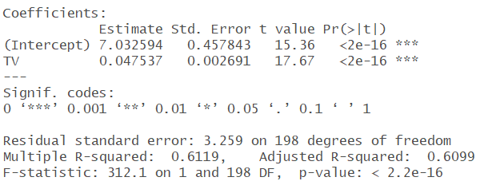
Simple Linear Regression using R
3. Is the relationship linear?

Slide 8
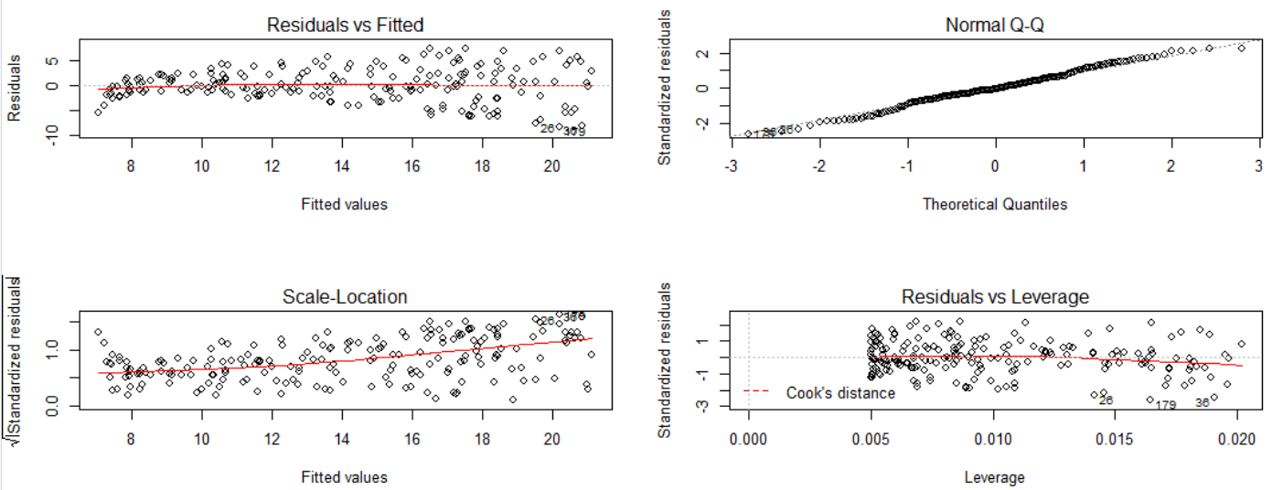
Simple Linear Regression using R
3. Is the relationship linear?

Slide 9
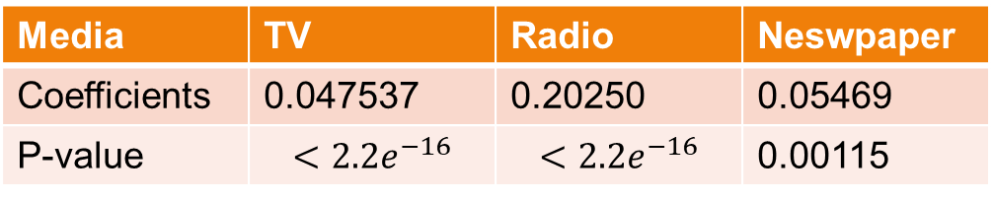
Simple Linear Regression using R
4. Which media contribute to sales?
Media | TV | Radio | Neswpaper
Coefficients | 0.047537 | 0.20250 | 0.05469
P-value | $$<{2.2e}^{−16}$$ | $$<{2.2e}^{−16}$$ | 0.00115

Slide 10
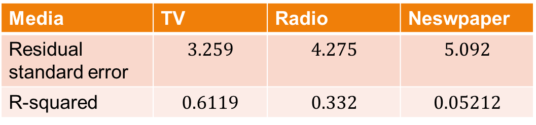
Simple Linear Regression using R
5. How accurately can we estimate the effect of each medium on sales?
Media | TV | Radio | Neswpaper
Residual standard error | $$3.259$$ | $$4.275$$ | $$5.092$$
R-squared | $$0.6119$$ | $$0.332$$ | $$0.05212$$

Slide 11
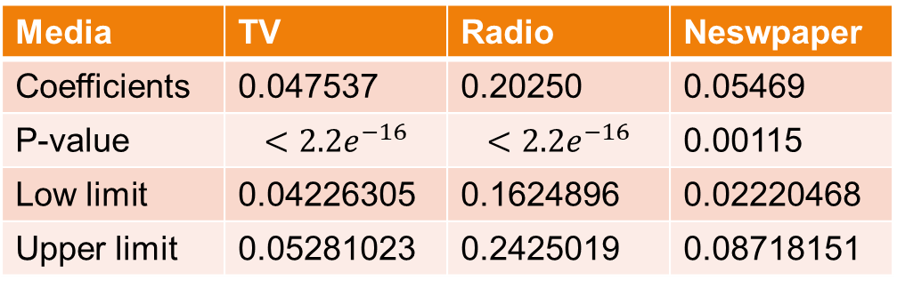
Simple Linear Regression using R
5. How accurately can we estimate the effect of each medium on sales?
Media | TV | Radio | Neswpaper
Coefficients | 0.047537 | 0.20250 | 0.05469
P-value | $$<{2.2e}^{−16}$$ | $$<{2.2e}^{−16}$$ | 0.00115
Low limit | 0.04226305 | 0.1624896 | 0.02220468
Upper limit | 0.05281023 | 0.2425019 | 0.08718151

Slide 12
Simple Linear Regression using R
6. How accurately can we predict future sales?
For the average response,
Media | TV | Radio | Neswpaper
Fit | 14.11555 | 13.76655 | 13.71873
Low limit | 13.66104 | 13.16827 | 12.98579
Upper limit | 14.57007 | 14.36482 | 14.45168

Slide 13
Simple Linear Regression using R
6. How accurately can we predict future sales?
For the individual response,
Media | TV | Radio | Neswpaper
Fit | 14.11555 | 13.76655 | 13.71873
Low limit | 7.673372 | 5.315078 | 3.649563
Upper limit | 20.55773 | 22.21801 | 23.78791

Slide 14
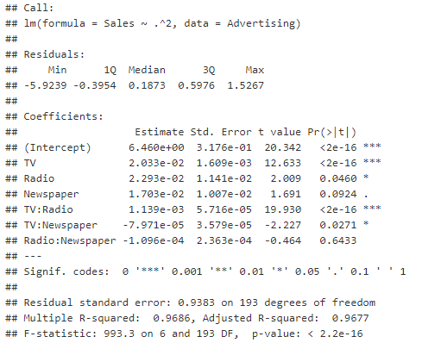
Simple Linear Regression using R
7.Is there synergy among the advertising media?

Slide 15

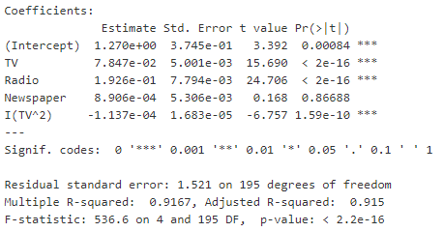
Simple Linear Regression using R
7.Is there synergy among the advertising media?
Non-linear transformations of the predictors

Slide 16
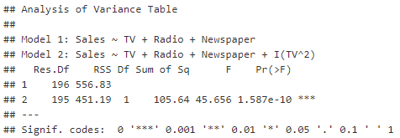
Simple Linear Regression using R
7.Is there synergy among the advertising media?
Comparing two models

